Slide 1
ATM Transaction Simulator
Aman 2620030458
Dhanush 2620090049

Slide 2
Abstract
The ATM Transaction Simulator is a console-based Java application that models basic ATM operations.
A user enters a demo PIN and can check the balance, deposit money, withdraw money, view transaction history, and save the history to a text file.
The project demonstrates fundamental Java programming, object-oriented design, exception handling, file I/O, collections, lambda expressions, and streams.
Initial demo balance: Rs. 10,000. Demo PIN: 1234. This is an educational simulation, not a real banking system.

Slide 3
Understanding Problem Statement
Problem: demonstrate the basic flow of an ATM using a simple, menu-driven program.
Inputs: demo PIN, menu choice, and transaction amount.
Processing: validate the PIN and amount; check available balance before withdrawal; update balance and transaction history.
Outputs: status messages, current balance, transaction history, and a saved text file.
Scope/assumptions: one in-memory demo account; no bank network, card reader, database, or real money movement.

Slide 4
CO 1 Topics
CO1 — Primitive types, expressions, and sequential console input/output.
Used in code: int for PIN/menu choice, double for balance and amount, and String for transaction type.
Scanner reads user input; System.out.println() displays menus, balances, and status messages.
Expressions update the balance: balance += amount and balance -= amount.

Slide 5
CO 2 TOPICS
CO2 — Selection and iteration control flow.
if / else validates the PIN, checks positive amounts, and prevents withdrawals above the balance.
switch selects the requested ATM operation from the menu.
do-while repeats the menu until the user chooses Exit (option 6).

Slide 6
CO 3 Topics
CO3 — Methods and modular problem solving.
Separate methods are used for deposit(), withdraw(), checkBalance(), showHistory(), and saveHistory().
The main() method coordinates input, menu selection, and calls to account operations.
This version uses methods but does not use recursion or array variables.

Slide 7
CO 4
CO4 — Classes, objects, encapsulation, and exception handling.
Transaction stores a transaction type and amount; ATMAccount manages the account state.
ATMAccount keeps balance and history private and exposes operations through public methods.
try-catch handles IOException if transaction history cannot be saved.

Slide 8
CO 5
CO5 — Strings, library APIs, and file input/output concepts.
String values represent transaction types and are combined into readable history entries using toString().
Paths.get() identifies atm_transactions.txt; Files.write() saves history to the file.
StandardOpenOption.CREATE creates the file when needed; APPEND adds records to existing content.

Slide 9
CO 6
CO6 — Collections, lambda expressions/method references, and streams.
ArrayList<Transaction> stores the transaction history dynamically.
history.stream().forEach(System.out::println) displays each transaction using a method reference.
history.stream().map(Object::toString).toList() transforms transactions into strings before saving.
Java 16 or later is required for Stream.toList() in this version.

Slide 10
Conclusion
The simulator demonstrates a basic ATM workflow through a menu-driven Java application.
It validates user choices and transaction amounts, updates the demo balance, and records transaction history.
The project connects concepts from CO1 through CO6: basic Java syntax, control flow, methods, OOP, file handling, and collections/streams.
Possible future improvements: multiple accounts, masked PIN input, persistent account balances, unit tests, and a graphical interface.

Slide 11
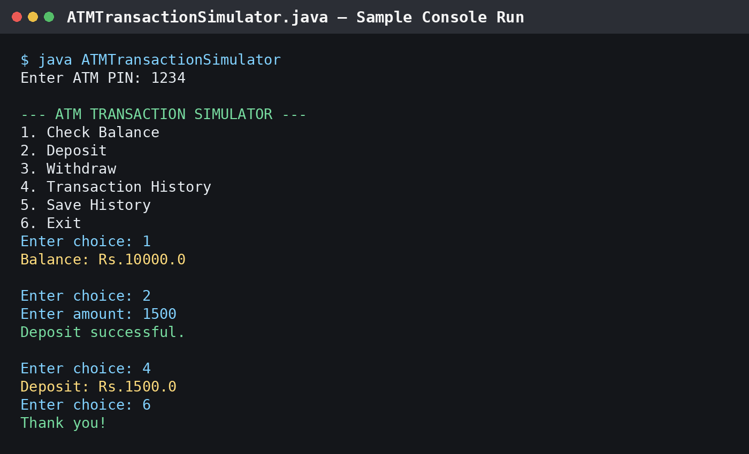
Screen Shots
Representative sample console run: PIN accepted, balance checked, deposit recorded, history displayed, and exit.

Slide 12
Geo Tag Photo and git hub link
Geo-tagged team photo: insert your original photo with location metadata here.
GitHub repository: add the repository URL after uploading ATMTransactionSimulator.java.
No geo-tagged photo or GitHub URL was provided, so these are left as clearly marked placeholders.

